Slide 1

VIX Index Based Retail Trader Tool
Rajeev Panwar
This Photo by Unknown Author is licensed under CC BY
Notes:
Good morning - Im here to pitch the VIX index based retail trader tool today - And to start with I would like to comment on the current investment reality

Slide 2
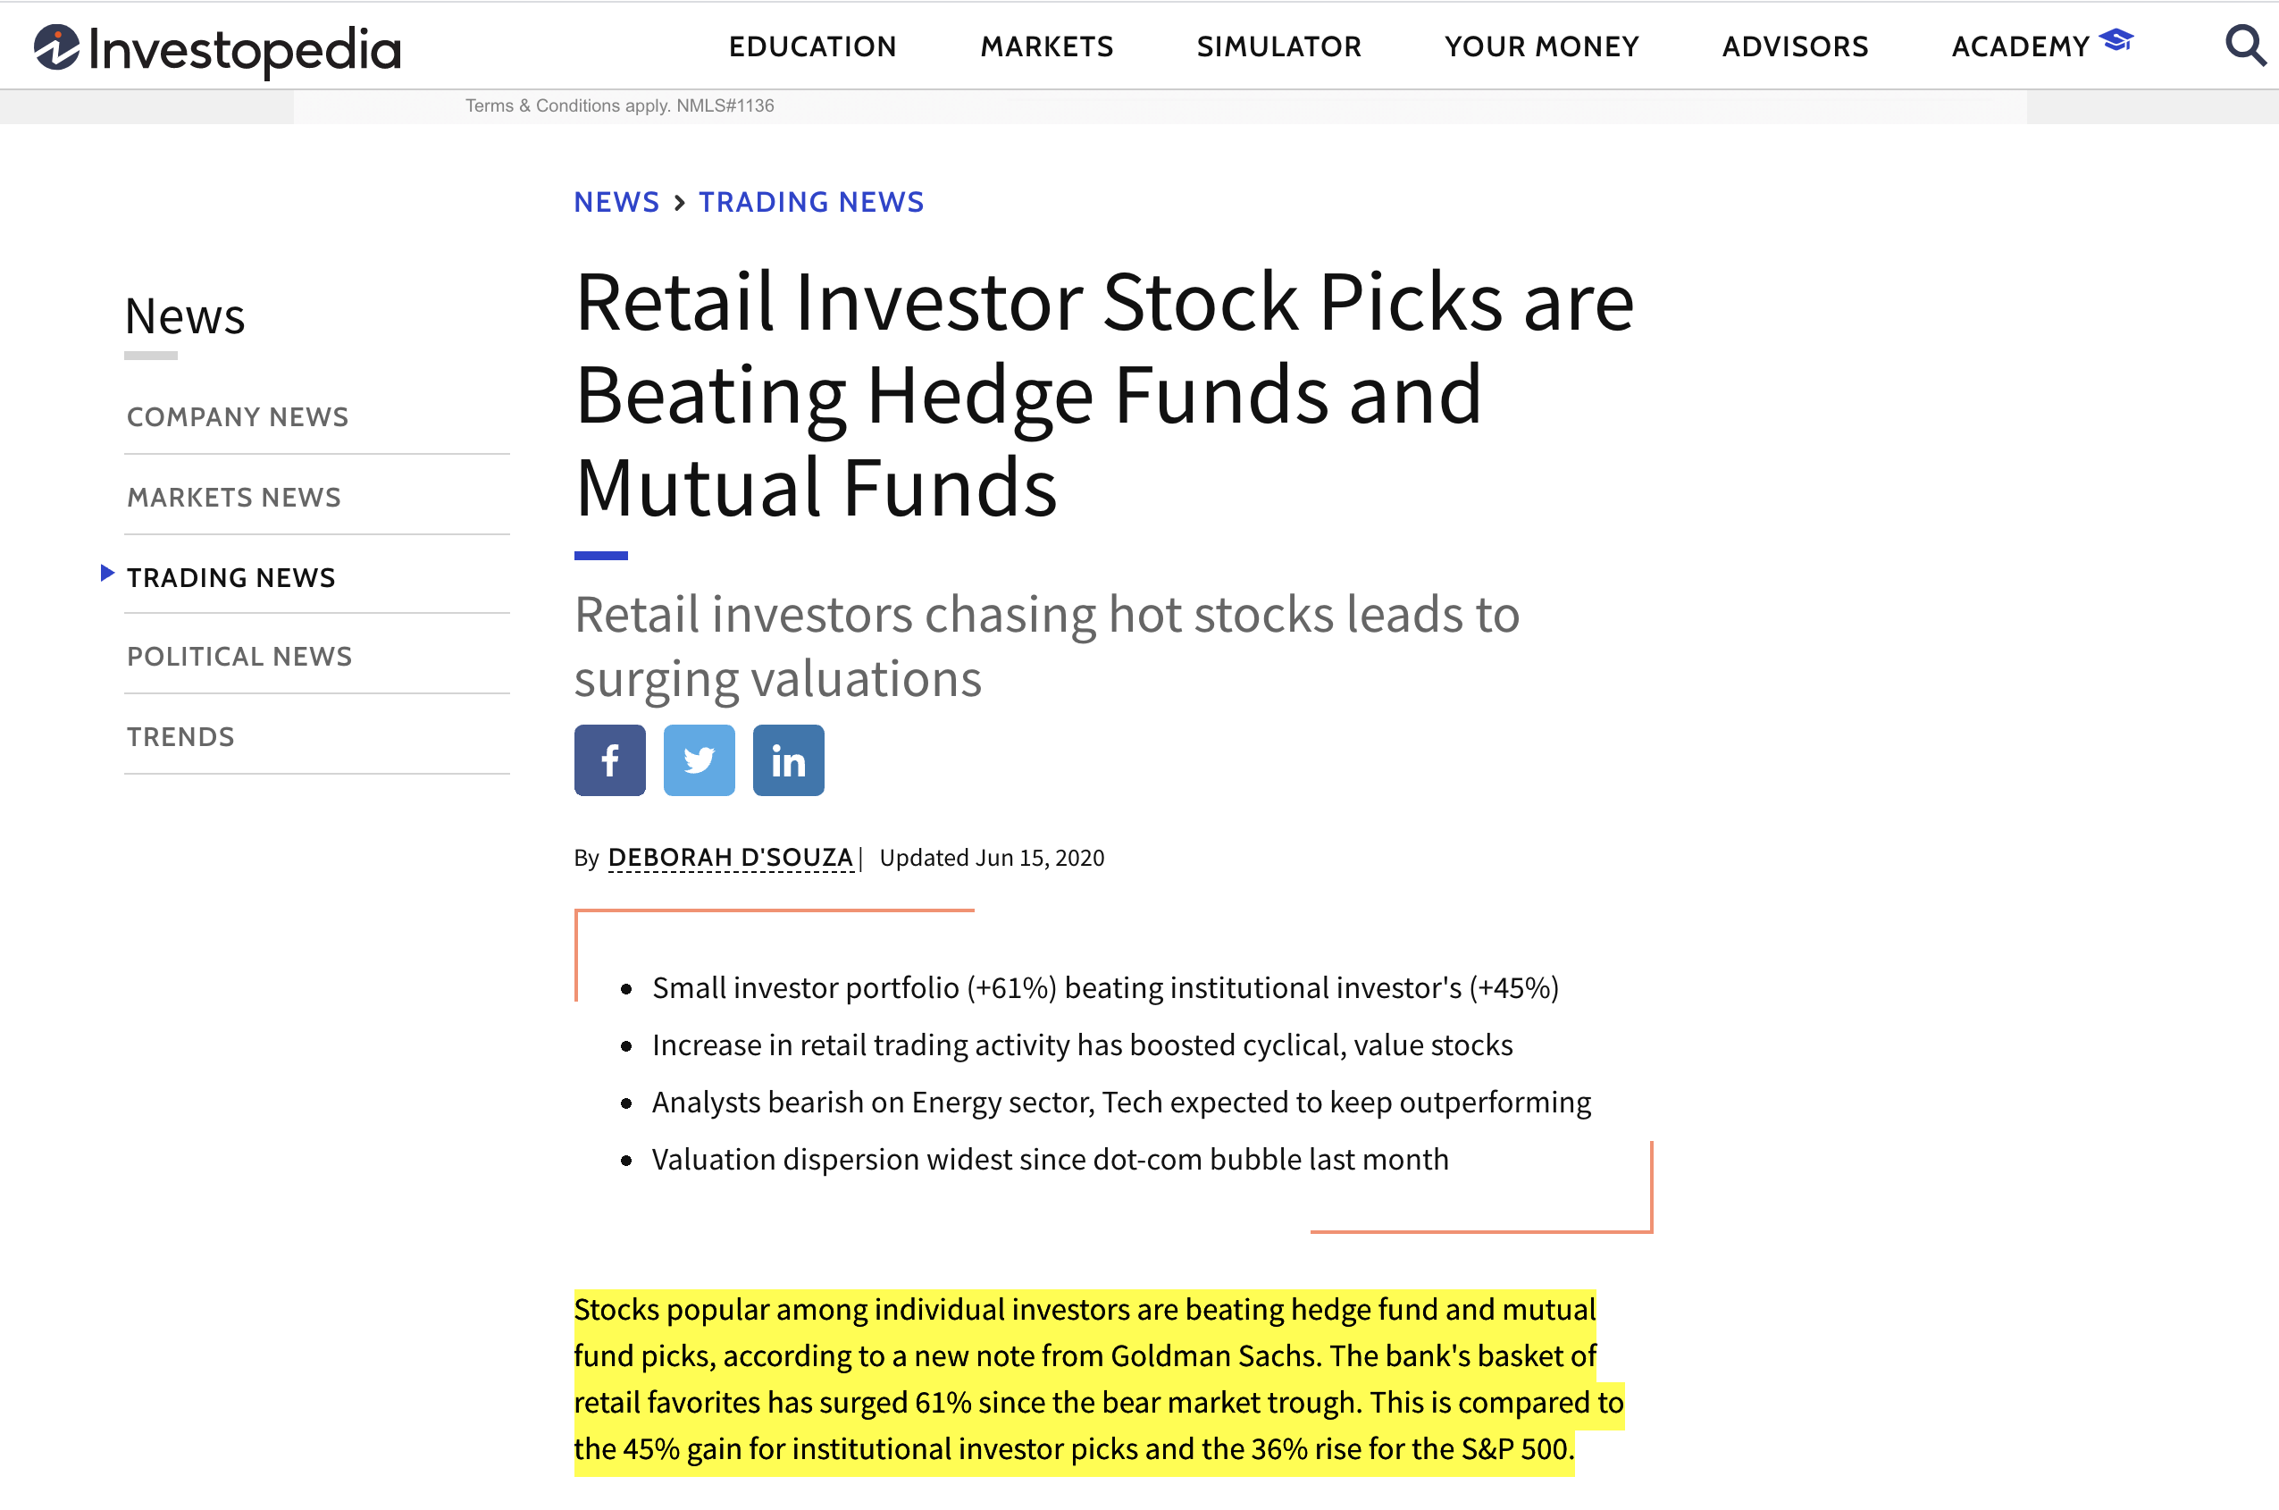
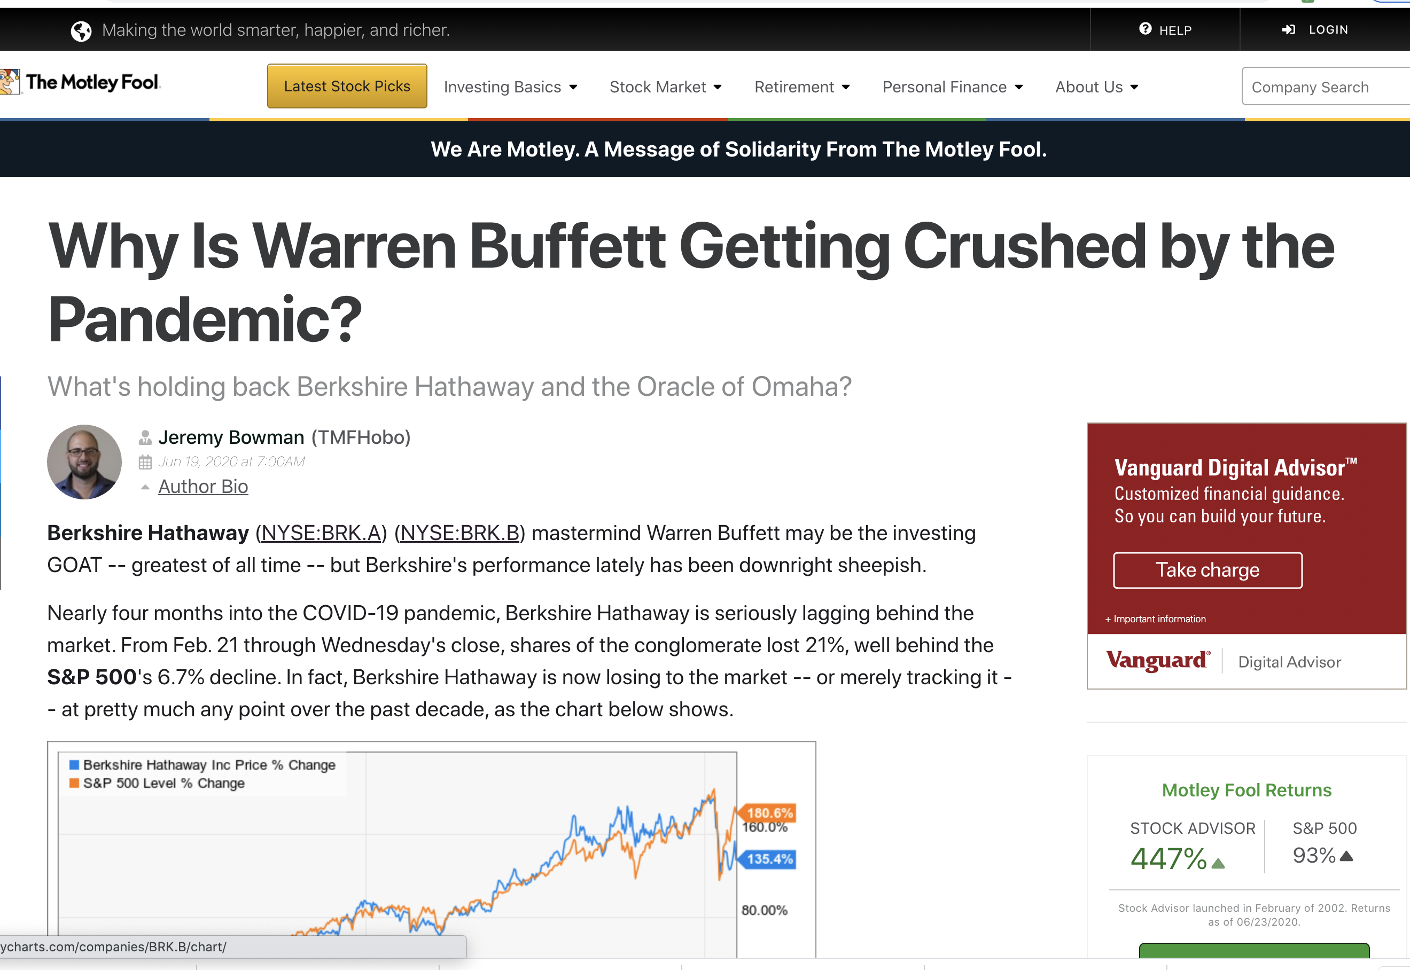
Current Investment Reality
Clearly a new breed of ‘smart’ mom/pop traders are starting to dominate Wall Street!

Slide 3
Beware - Danger Lurks!
Competing against Machine Learning Trading Algorithms that feed of real time volatility data – ‘computational outmatched’
Market Volatility – Friend or Foe?
Notes:
Depends on which kind of trader you’re talking to

Slide 4
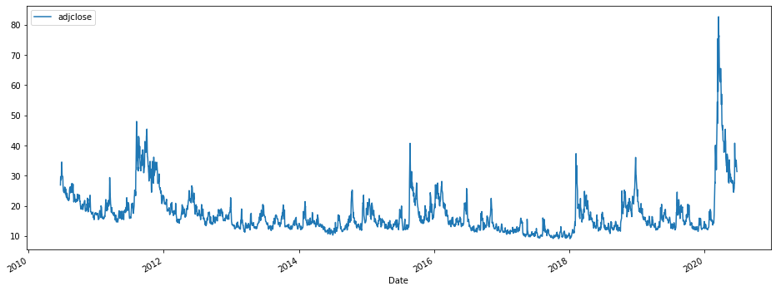
Volatility Index (VIX) aka ‘fear gauge’ or ’fear index’
VIX Index | 16 | 25 | 35 | 45
Implied Annual % | 16% | 25% | 35% | 45%
VIX Index | Mean | SD | 50% | 75% | Max
Key Facts | ~17 | ~7 | ~15 | ~19 | ~82
Covid-19
Mid-term election –
2012
Election Year & Big Tax Cut
Index Value
Trade War & Iran Crises
Year
Widely acknowledged as the best indicator of implied future volatility (for over 25 years)
Challenge – CBOE VIX is for most part inscrutable to the retail mom/pop investor
Key characteristics - ‘long term mean reversion’ and ‘inversely co-related with S&P500’

Slide 5
the process (MVP)
Develop trading strategy tool to alert retail investor on expected % movement over predicted time period ‘t’ (Final Product)
5
Complete - LSTM
Stretch goal – identify key thresholds for development of alert system
4
MVP
Time series forecast VIX using a baseline model, ARIMA & PROPHET – Evaluation Criteria - RMSE
3
Exploratory data analysis
2
Web-scraped historic daily adjusted closing price from Yahoo Finance – 10 years of VIX Index prices ~ 2517 observations
1

Slide 6
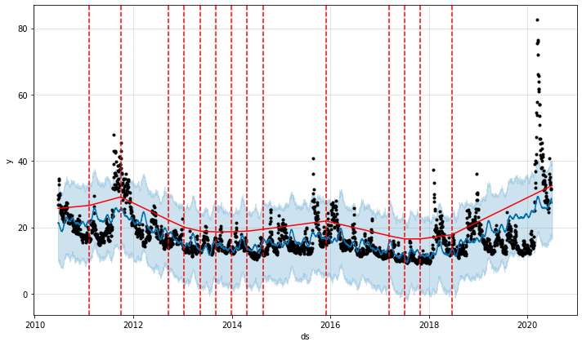
Verifying Key Changepoint Using Prophet
Covid-19
Mid-term election –
2012
Trade War & Iran Crises
Election Year & Big Tax Cut
Index Value
Year

Slide 7
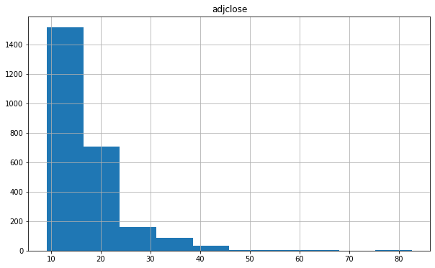
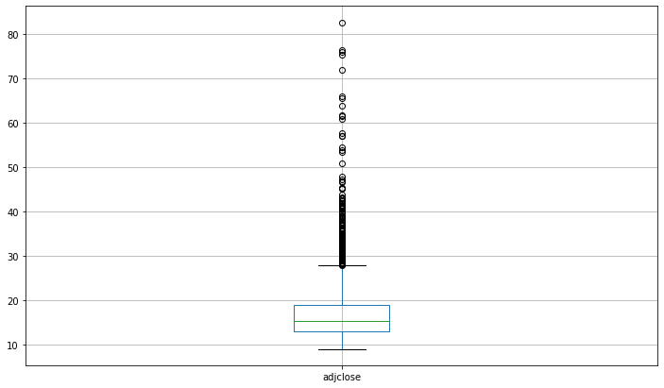
How frequently do investors tend to panic!
Number of Observations
Index Value
Thank-fully Institutional investors seem to be pretty level-headed for the most decade

Slide 8
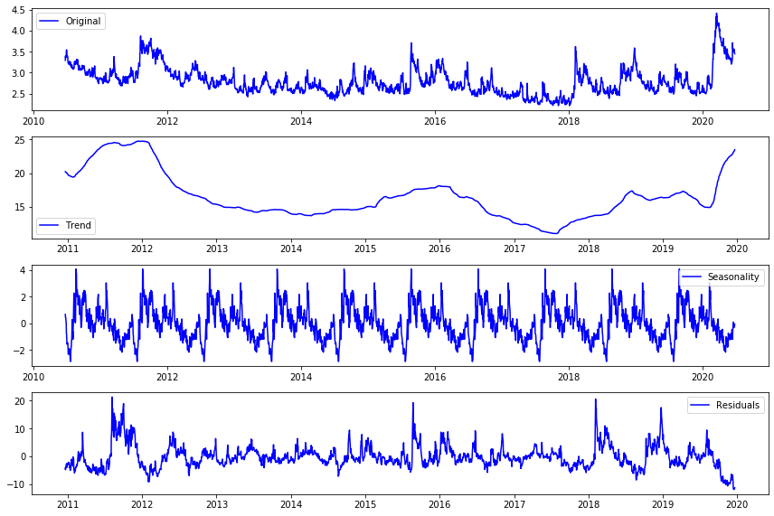
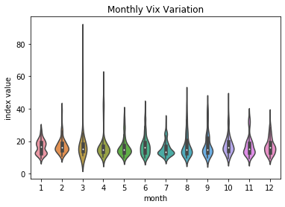
Interesting Findings!
End of Q1 & Q2 seem to experience more volatility than the latter half of year – Q2 2020 is coming up! Buckle up!!!

Slide 9
Modelling VIX
Model | RMSE
Baseline | 3.34
Prophet | 5.78
Arima (5,0,1) | 2.94
LSTM | Yet to be build
Baseline (persistence) didn’t do too badly
Prophet saw the lowest RMSE for the 2nd & 8th day forecast
ARIMA did the best of the 3 models tried
Hoping LSTM can improve on the performance of every other model tried

Slide 10
Thank You – Questions?

Slide 11
APPENDIX
# Volatility Index Enabled Trading Alert System #
### Business Case ###
The world is living through its 2nd pandemic of 21st Century (first being 2009 H1N1 influenza pandemic). In midst of all this doom and stock market gyrations, one category of investors has stood tall and more often than not only beaten established mutual funds and hedge funds. More and more news headlines attest to this fact as we enter the 2nd half of 2020
As the current crises continues to increase volatility due to conflicting progress against COVID-19 and a monumental Presidential election around the corner, its imperitive that small mom/pop trader better understand volatility and utilize cutting edge data science techniques to forecast expected volatility and incorporate these insights regarding volatility into stock-trading behavior
For most mom/pop investors focusing on investing in cyclicals like Technology stocks, valuations are increasing a function of sentiment and subject to 'substiantial' change when other sectors of the economy recover
We have all heard the maxim - 'buy when others sell and sell when others buy'. One literal intrepration of this maxim would be to buy when others are fearful and panicking and sell when others are overly europhic and start buying
Clearly there is a use case for a volatility predictor which can be used to improve 'entry' and 'exit' strategies
While it is widely acknowledged that predicting asset prices is a perilous profession, I believe there maybe a workaround in trying to predict broader market volatility and explore if such insight can augment trading strategies in such times
### Associated Sub-theme (For Stretch Goal) ###
I also wanted to explore if investors experienced different levels of volatility under two Presidents and extract insights for a major upcoming event that will be 'cataclysmic' from a volatility standpoint - the 2020 Presidential Election - irrespective of who wins!
### Using Data Science to Demystify/Understand Volatility ###
While looking for data to best understand volatility for trading, I choose the CBOE Volatility Index (VIX) - VIX is widely acknowledged as the foremost indicator of implied market volatility for over 25 years
So what is the VIX? Its a real-time market index that represents the market's expectation of 30-day forward-looking volatility. VIX estimates how volatile the market will be by aggregating the weighted prices of S&P 500 puts and calls over a wide range of strike prices. More specifically, the VIX is calculated by looking at the midpoints of real-time S&P 500 option bid and ask prices
Why VIX - Unlike indiviual stocks in S&P500 (and associated option chains) which may be undergoing some structural realingment (GE & BOEING are classic examples), VIX is 'diversified' and 'balanced' number that most accurately estimates investor sentiment going into the future. Since VIX is derived from future price expectations for every stock on the S&P500, it accurately captures the hedging strategies of large institutional players - which in turn impact current and future stock prices
Key Charateristic of Index - 'Long Term Mean Reversion' - Simply put folks dont stay fearful for too long nor do they remain euphoric all the time to whatever happens (Clearly investors could also benefit from learning Zazen and other zen meditation techniques but I'll save that for a later blog about how to maintain equanimity during 'high-volatility' trading sessions)
Another important 'lesser' charateristic is that VIX has a strong negative correlation to the S&P 500, tending to rise when the stock market dives, and vice versa, and as such futures based on the VIX, traded at the CBOE (retail buyers hardly use CBOE since its been designed for large institutional investors), can be an effective vehicle for hedging stock market positions
### Steps to Solutioning ###
1. Data Gathering - I webscraped 2517 observations for daily adjusted closing prices of VIX starting '2010-06-23' to '2020-06-24' to build the volatility predictor. gathered data was stored in a 'pickle'.
2. Data Pre-processing - Use of datetimestamp and index
3. Exploratory Data Analysis
4. Model Development and Evalution Criteria (RMSE)
1. Baseline - Persistence Model
2. Facebook Prophet
3. ARIMA
4. LSTM (for final presentation)
5. Choice of Preferred Predictor Explained - the best performing model is the baseline - Persistence Model with a RMSE of 3.34 - I'm hoping the LSTM can outperform the baseline model
### Key Findings about the VIX ###
1. Mean ~ 17 with Standard Deviation - ~7
2. Highest recorded value - ~82 (March 2020 - peak of market meltdown in response to Covid19 lockdown)
3. End of Q1 & Q2 see most volatility - End of a critical Q2 is upon us!!!
4. Elections (We have a big one coming up) result in a spike in volatility
5. Relative rate of change in volatility needs to factored in building models that use short term change in VIX to predict
### Future Steps ###
Each VIX index value represents an implied annual volatility for the S&P500. So a VIX of 16 implies an annual implied change (up or down) of 16% in the S&P
For a day trader/scalper/swing trader, this 16% implied annual volatility remains instrutable however when converted into a daily implied movement of ~1 % (16/sqrt(252)), things start to make sense. Within periods of high volatility movement (Incremental bands of 10), scalpers can look to make anywhere from 1-5% unleveraged returns over a 3-4 period (provided they make the right picks of course)
Stock picking itself will
Defend - 70% weight to VIX Predictor + 30% weight to
Hardball
Attack (Chase stocks with highest delta weighed by a 'barometric' measure of noise around companies - follow the noise and hope it works out)
3rd most critical input - and most exciting challenge would be trading volumes to estimate (how much incremental change is happening in stock due to rebalancing of futures markets)
I aim to fine-tune the predictor and identify critical thresholds that can serve as 'triggers' for traders (subscribing to my app). Alerts would be generated when 'relative' volatility changes help identify start of high 'fear' cycles aka buying opportunities and low 'fear' cycles aka sell high and sit on cash
The END GOAL - develop a combinatory model that weighs 3 primary indicators of volatility - 15 day rolling prediction based on an series of LSTM's that predict for narrow bands of movement th VIX to 'magnitudely' predict market movements and then leave it to the sensibility of an average Joe to decide whats selling around him, whats not, who's talking about stuff more on their social media feeds, what are folks worried about!!! etc - "in rolling seas are magnificients beasts of the ocean found" (of course in the short run) so traders can factor in VIX into decision making
To conclude:
“My interest is in the future…I am going to spend the rest of my life there”
– C.F. Kettering
### Links to Presentation & Academic Literature
Presentation - https://docs.google.com/presentation/d/1ZFODWgJR_lD_ECELpOK0WLRsaTyFbnwPVT3cFBHadls/edit?usp=sharing
Articles Reviewed
1. General Overview
- https://www.spglobal.com/spdji/en/education-a-practitioners-guide-to-reading-vix.pdf
- https://www.investopedia.com/ask/answers/010915/volatility-good-thing-or-bad-thing-investors-point-view-and-why.asp
- https://ftalphaville.ft.com/2018/02/28/1519839805000/An-abridged--illustrated-history-of-volatility/
2. Weakness - https://www.barrons.com/articles/the-pros-and-cons-of-vix-the-markets-fear-gauge-1505942074
### Sources for Code, Images etc ###

Slide 12
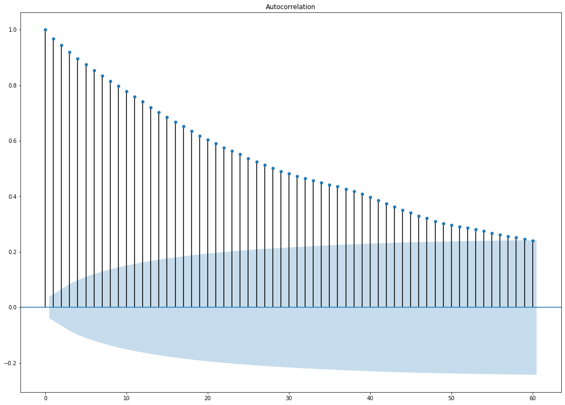
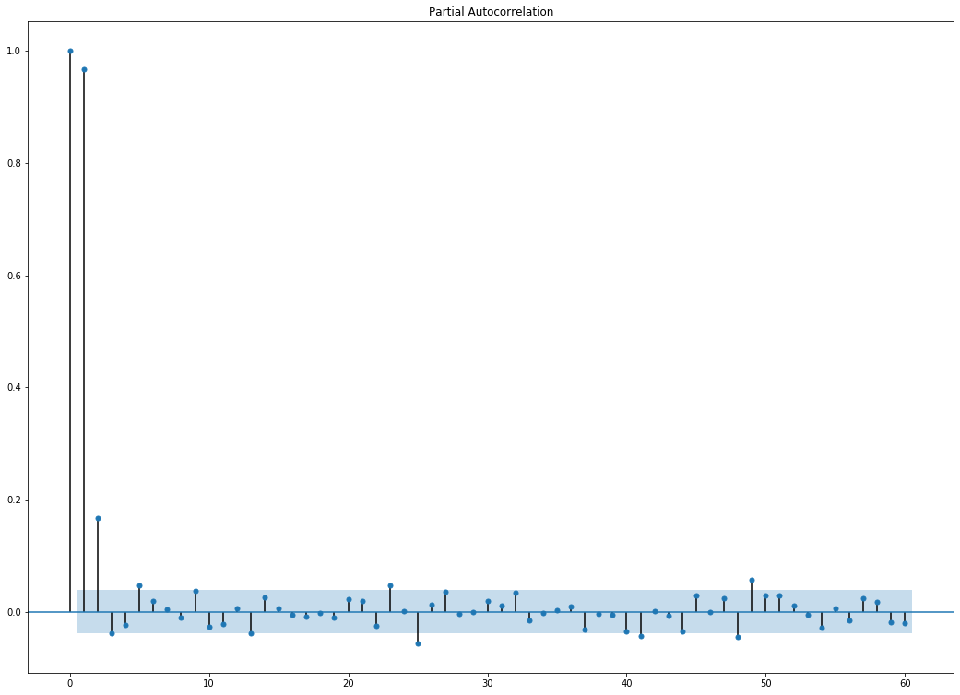
ACF & PACF

